Slide 1


ACCT 2003 Intermediate Financial Accounting 中级财务会计
THE HITSZ
SCHOOL OF ECONOMICS
AND MANAGEMENT
授课人：墙伟
2024.10.09

Slide 2

LEARNING OBJECTIVES
CHAPTER 11
Depreciation,
Impairments, and Depletion
After studying this chapter, you should be able to:
Describe depreciation concepts and methods of depreciation.
Identify other depreciation issues.
Explain the accounting issues related to asset impairment.
Demonstrate how to report and analyze property, plant, equipment.

Slide 3
LEARNING OBJECTIVE 1
Describe depreciation concepts and methods of depreciation.

Slide 4
Depreciation—A Method of Cost Allocation 折旧
Depreciation is the accounting process of allocating the cost of tangible assets to expense in a systematic and rational manner to those periods expected to benefit from the use of the asset.
Allocating costs of long-lived assets:
Fixed assets = Depreciation expense 折旧费用
Intangibles = Amortization expense 摊销费用
LO 1
Notes:
The cost allocation approach is justified because it matches costs with revenues and because fluctuation in market values is difficult to determine.

Slide 5

单选题
1分
此题未设置答案，请点击右侧设置按钮
Quick Check #1
Which of the following is not true of depreciation accounting?
A
Depreciation lowers the book value of the asset as it ages and its fair value declines.
B
Depreciation matches expenses against revenues over the periods which benefit from the asset’s use.
C
Depreciation is a process of cost allocation.
D
Tangible assets with limited lives are depreciated.
Submit

Slide 6
Depreciation—Method of Cost Allocation
Factors Involved in the Depreciation Process
Three basic questions:
What depreciable base is to be used?
What is the asset’s useful life?
What method of cost apportionment is best?
LO 1
Notes:
To compute depreciation, an accountant must establish (a) the depreciable base to be used for the asset, (b) the asset’s useful life, and (c) the depreciation method to be used. Determination of the first two factors requires the use of estimates.

Slide 7
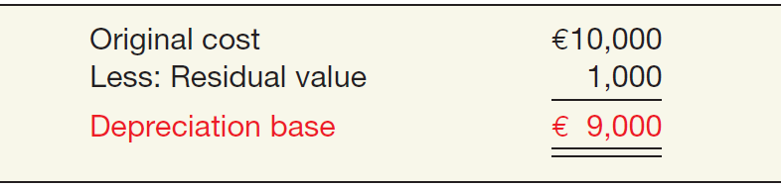
Factors Involved in Depreciation Process
Depreciable Base for the Asset 应计折旧额
ILLUSTRATION 11.1
Computation of Depreciation Base
LO 1
Notes:
The depreciable base is the difference between an asset’s cost and its residual value. Residual value (or salvage value) is the estimated amount that will be received at the time the asset is sold or removed from service.
From a practical standpoint, companies often assign a zero residual value. Some long-lived assets, however, have substantial residual values.

Slide 8
Factors Involved in Depreciation Process
Estimation of Service Lives 预计资产使用寿命
Service life often differs from physical life.
Companies retire assets for two reasons:
Physical factors (casualty or expiration of physical life).
Economic factors (inadequacy 产能不足, supersession 取代更新, and obsolescence 废弃).
LO 1
Notes:
The useful life (service life) of a plant asset refers to the number of years that asset is capable of economically providing the service it was purchased to perform. The service life of an asset should not be confused with its physical life. For example, a machine may no longer provide a useful service to an organization even though it remains physically functional. Thus, the estimate of an asset’s service life is dependent upon both the economic factors and the physical factors related to its use. Economic factors are characterized by inadequacy, supersession, and obsolescence. Physical factors relate to wear and tear, decay, and casualties that prevent the asset from performing indefinitely.
Inadequacy results when an asset ceases to be useful to a company because the demands of the firm have changed.
Supersession is the replacement of one asset with another more efficient and economical asset.
Obsolescence is the catchall for situations not involving inadequacy and supersession.
To illustrate the concepts of physical and economic factors, consider a new nuclear power plant. Which is more important in determining the useful life of a nuclear power plant—physical factors or economic factors? The limiting factors seem to be (1) ecological considerations, (2) competition from other power sources, and (3) safety concerns. Physical life does not appear to be the primary factor affecting useful life. Although the plant’s physical life may be far from over, the plant may become obsolete in 10 years.

Slide 9
单选题
1分
此题未设置答案，请点击右侧设置按钮
Quick Check #2
The major difference between the service life of an asset and its physical life is that
A
service life refers to the time an asset will be used by a company and physical life refers to how long the asset will last.
B
physical life is the life of an asset without consideration of salvage value and service life requires the use of salvage value.
C
physical life is always longer than service life.
D
service life refers to the length of time an asset is of use to its original owner, while physical life refers to how long the asset will be used by all owners.
Submit

Slide 10
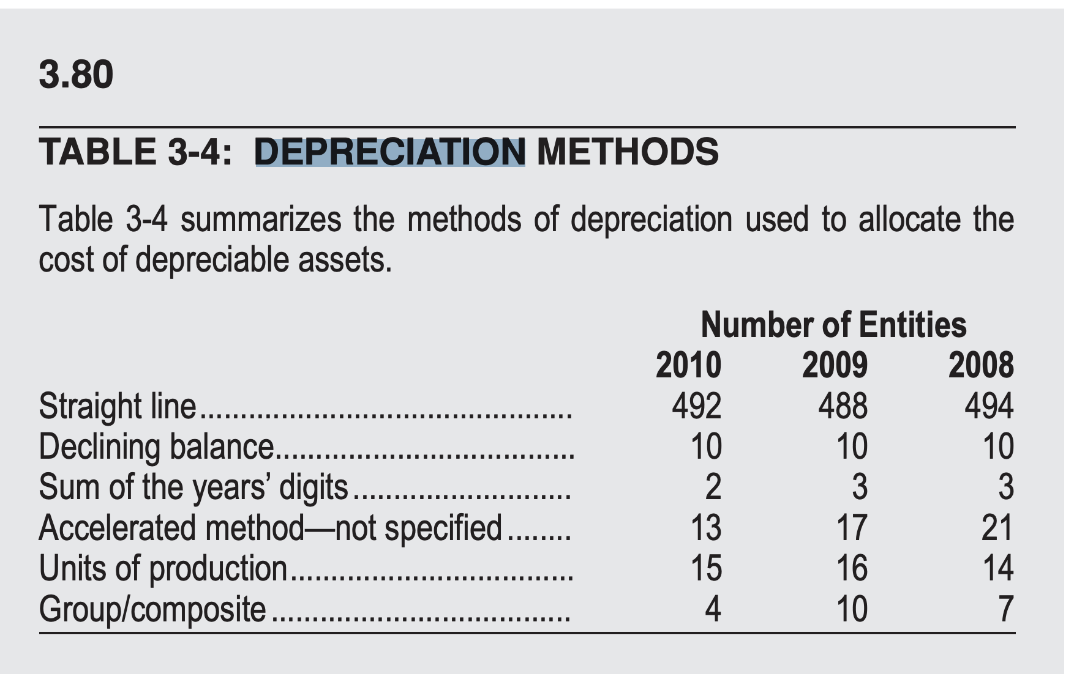
Depreciation—Method of Cost Allocation
Methods of Depreciation
The profession requires the method employed be “systematic and rational.” Methods used include:
Activity method (units of use or production). 工作量法
Straight-line method. 直线折旧法
Diminishing (accelerated)-charge methods: 加速折旧法
Sum-of-the-years’-digits. 年数总和法
Declining-balance method. 余额递减法
LO 1
Notes:
To be systematic and rational, the depreciation method should reflect the pattern in which the asset’s future economic benefits are expected to be consumed by the company.

Slide 11
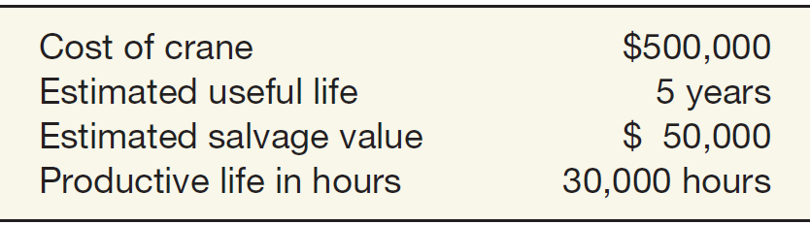
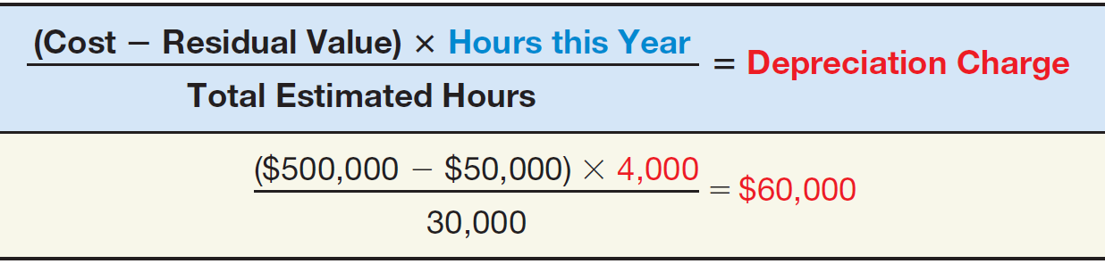
Methods of Depreciation
Activity Method 工作量法
ILLUSTRATION 11.2
Data Used to Illustrate
Depreciation Methods
Data for Stanley Coal Mines
Illustration: If Stanley uses the crane for 4,000 hours the first year, the depreciation charge is:
ILLUSTRATION 11.3
Depreciation Calculation,
Activity Method—Crane
Example
LO 1
Notes:
The activity method (also called the variable-charge or units-of-production approach) assumes that depreciation is a function of use or productivity, instead of the passage of time.
A company considers the life of the asset in terms of either the output it provides (units it produces) or an input measure such as the number of hours it works.
The major limitation of this method is that it is inappropriate in situations in which depreciation is a function of time instead of activity. In addition, where economic or functional factors affect an asset, independent of its use, the activity method loses much of its significance. For example, if a company is expanding rapidly, a particular building may soon become obsolete for its intended purposes.
Another problem in using an activity method is the difficulty of estimating units of output or service hours received.

Slide 12
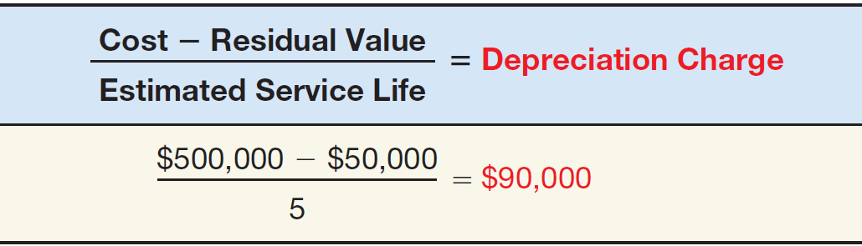
Methods of Depreciation
Straight-Line Method 直线折旧法
ILLUSTRATION 11.2
Data Used to Illustrate
Depreciation Methods
Data for Stanley Coal Mines
Illustration: Stanley computes depreciation as follows:
ILLUSTRATION 11.4
Depreciation Calculation,
Straight-Line Method—Crane Example
LO 1
Notes:
The straight-line method considers depreciation as a function of time rather than as a function of usage.
The major objection to the straight-line method is that it rests on two tenuous assumptions: (1) the asset’s economic usefulness is the same each year, and (2) the maintenance and repair expense is essentially the same each period.

Slide 13
单选题
1分
Quick Check #3
A principal objection to the straight-line method of depreciation is that it
此题未设置答案，请点击右侧设置按钮
A
provides for the declining productivity of an aging asset.
B
ignores variations in the rate of asset use.
C
tends to result in a constant rate of return on a diminishing investment base.
D
gives smaller periodic write-offs than decreasing charge methods.
Submit

Slide 14
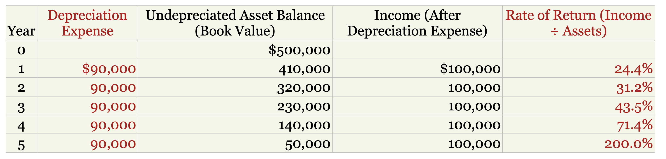
单选题
0.5分
此题未设置答案，请点击右侧设置按钮
Quick Check #3
B
tends to result in a constant rate of return on a diminishing investment base.
Submit

Slide 15
Methods of Depreciation
Diminishing-Charge Methods 加速折旧法
ILLUSTRATION 11.2
Data Used to Illustrate
Depreciation Methods
Data for Stanley Coal Mines
Sum-of-the-Years’-Digits. Each fraction uses the sum of the years as a denominator (5 + 4 + 3 + 2 + 1 = 15). The numerator is the number of years of estimated life remaining as of the beginning of the year.
Alternate sum-of-the-years’ calculation
n(n+1)
5(5+1)
=
=
15
2
2
LO 1
Notes:
The diminishing-charge methods provide for a higher depreciation cost in the earlier years and lower charges in later periods.
What is the main justification for this approach? The rationale is that companies should charge more depreciation in earlier years because the asset is most productive in its earlier years
Furthermore, the accelerated methods provide a constant cost because the depreciation charge is lower in the later periods, at the time when the maintenance and repair costs are often higher.

Slide 16
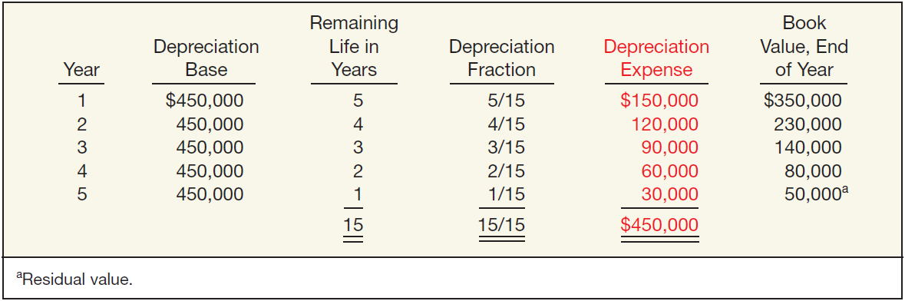
Methods of Depreciation
Sum-of-the-Years’-Digits 年数总和法
ILLUSTRATION 11.6
Sum-of-the-Years’-Digits Depreciation Schedule—Crane Example
LO 1

Slide 17
Methods of Depreciation
Diminishing-Charge Methods
ILLUSTRATION 11.2
Data Used to Illustrate
Depreciation Methods
Data for Stanley Coal Mines
Declining-Balance Method. 余额递减法
Utilizes a depreciation rate (percentage) that is some multiple of the straight-line method.
Does not deduct the salvage value in computing the depreciation base.
LO 1
Notes:
For example, the double-declining rate for a 10-year asset is 20 percent (double the straight-line rate, which is 1⁄10, or 10 percent). Companies apply the constant rate to the declining book value each year.

Slide 18
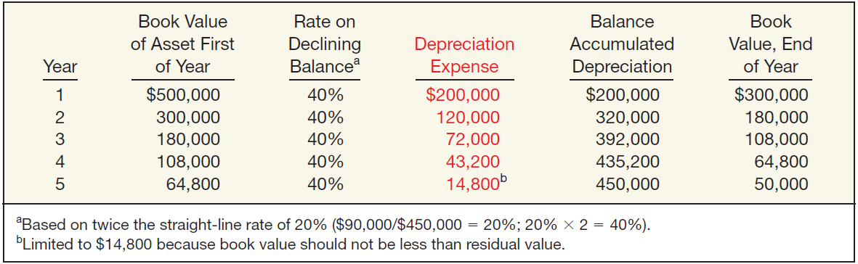
Methods of Depreciation
Declining-Balance Method 余额递减法
ILLUSTRATION 11.7
Double-Declining Depreciation Schedule—Crane Example
LO 1
Notes:
The declining-balance rate is multiplied by the book value of the asset at the beginning of each period. Since the depreciation charge reduces the book value of the asset each period, applying the constant-declining-balance rate to a successively lower book value results in lower depreciation charges each year. This process continues until the book value of the asset equals its estimated residual value. At that time, the company discontinues depreciation.

Slide 19
单选题
1分
Quick Check #4
Lundy Company purchased a depreciable asset for $99,000. The estimated salvage value is $18,000, and the estimated useful life is 9 years. The double-declining balance method will be used for depreciation. What is the depreciation expense for the second year on this asset? Round the depreciation rate to nearest whole percentage.
此题未设置答案，请点击右侧设置按钮
A
$11,000
B
$13,900
C
$16,988
D
$17,820
Submit

Slide 20
LEARNING OBJECTIVE 2
Identify other depreciation issues.

Slide 21
Other Depreciation Issues
Component Depreciation 零部件折旧
IFRS requires that each part of an item of property, plant, and equipment that is significant to the total cost of the asset must be depreciated separately.
LO 2
Notes:
As an example, when a company like Nokia (FIN) purchases a building, it must determine how the various building components (e.g., the foundation, structure, roof, heating and cooling system, and elevators) should be segregated and depreciated.

Slide 22
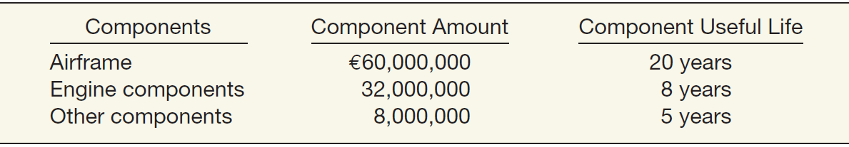
Component Depreciation
Illustration: EuroAsia Airlines purchases an airplane for €100,000,000 on January 1, 2020. The airplane has a useful life of 20 years and a residual value of €0. EuroAsia uses the straight-line method of depreciation for all its airplanes. EuroAsia identifies the following components, amounts, and useful lives.
ILLUSTRATION 11.8
Airplane Components
LO 2

Slide 23
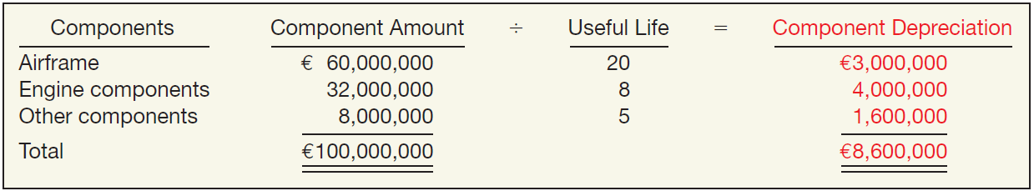
Component Depreciation
Computation of depreciation expense for EuroAsia for 2020.
ILLUSTRATION 11.9
Computation of
Component Depreciation
Depreciation journal entry for 2020.
Depreciation Expense 8,600,000
折旧费用
Accumulated Depreciation—Equipment 8,600,000
累计折旧——设备——Airplane
LO 2

Slide 24
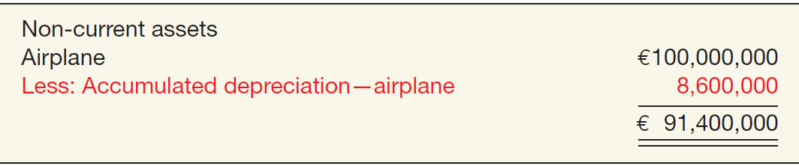
Component Depreciation
On the statement of financial position at the end of 2020, EuroAsia reports the airplane as a single amount.
ILLUSTRATION 11.10
Presentation of Carrying Amount of Airplane
LO 2

Slide 25
Other Depreciation Issues
Depreciation and Partial Periods
How should companies compute depreciation for partial periods?
Companies determine the depreciation expense for the full year and then
prorate this depreciation expense between the two periods involved.
This process should continue throughout the useful life of the asset.
LO 2

Slide 26
Depreciation and Partial Periods
Illustration—(Four Methods): Maserati SpA purchased a new machine for its assembly process on August 1, 2019. The cost of this machine was €150,000. The company estimated that the machine would have a salvage value of €24,000 at the end of its service life. Its life is estimated at 5 years and its working hours are estimated at 21,000 hours. Year-end is December 31.
Instructions: Compute the depreciation expense under the following methods.
(a) Straight-line depreciation. (c) Sum-of-the-years’-digits.
(b) Activity method (d) Double-declining balance.
LO 2

Slide 27
Depreciation and Partial Periods
Straight-line Method
LO 2

Slide 28
Depreciation and Partial Periods
Activity Method
(Assume 800 hours used in 2019)
LO 2

Slide 29
Depreciation and Partial Periods
Activity Method
(Assume 800 hours used in 2019)
LO 2

Slide 30
Depreciation and Partial Periods
Sum-of-the-Years’-Digits Method
5/12 = .416667
7/12 = .583333
LO 2

Slide 31
Depreciation and Partial Periods
Sum-of-the-Years’-Digits Method
5/12 = .416667
7/12 = .583333
LO 2
Notes:
4.58/15 = 5/15*7/12+4/15*5/12

Slide 32
Depreciation and Partial Periods
Double-Declining Balance Method
 | Depreciable |  | Rate |  | Annual |  | Partial |  | Year | Accum.
Year | Base |  | per Year |  | Expense |  | Year |  | Expense | Deprec.
2019 | € 150,000 | x | 40% | = | € 60,000 | x | 5/12 | = | € 25,000 | 25, 000
2020 | 150,000 | x | 40% | = | 60,000 | x | 7/12 | = | 35,000
 | 90,000 | x | 40% | = | 36000 | x | 5/12 | = | 15,000 | 50,000
2021 | 90,000 | x | 40% | = | 36,000 | x | 7/12 | = | 21,000
 | 54,000 | x | 40% | = | 21,600 | x | 5/12 | = | 9,000 | 30,000
2022 | 54,000 | x | 40% | = | 21,600 | x | 7/12 | = | 12,600
 | 8,400 | x | 50% | = | 4,200 | x | 5/12 | = | 1,750 | 14,350
2023 | 8,400 | x | 50% | = | 4,200 | x | 7/12 | = | 2,450
 | 8,400 | x | 50% | = | 4,200 | x | 5/12 | = | 1,750 | 4,200
2024 | 8,400 | x | 50% | = | 4,200 | x | 7/12 | = | 2,450 | 2,450
 | Journal Entry |  |  |  |  |  |  |  | € 126,000 | 126,000
2019 | Depreciation expense |  |  |  |  |  | 25,000
 | Accumulated depreciation |  |  |  |  |  |  |  | 25,000
* | Change to straight-line method in the last two years.
LO 2

Slide 33
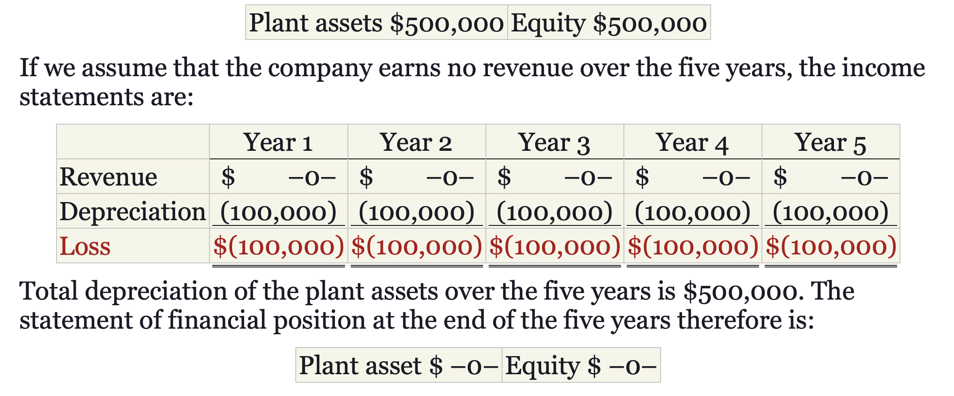
Other Depreciation Issues
Depreciation and Replacement of PP&E
Does depreciation provide for the replacement of assets?
Does not involve a current cash outflow.
Funds for the replacement of the assets come from the revenues (generated through use of the asset).
LO 2
Notes:
A common misconception about depreciation is that it provides funds for the replacement of property, plant, and equipment.
This extreme example illustrates that depreciation in no way provides funds for the replacement of assets. The funds for the replacement of the assets come from the revenues (generated through use of the asset).

Slide 34
Other Depreciation Issues
Revision of Depreciation Rates 折旧率调整
IFRS requires that companies review the estimates for residual value and service life annually and revise them if needed.
How should companies handle revisions in depreciation rates?
Accounted for in the current and prospective periods
Not handled retrospectively
Not considered errors or extraordinary items
LO 2
Notes:
As a result, IFRS requires that companies review the estimates for residual value and service life annually and revise them if needed.
Unexpected physical deterioration or unforeseen obsolescence may decrease the estimated useful life of the asset. Improved maintenance procedures, revision of operating procedures, or similar developments may prolong the life of the asset beyond the expected period

Slide 35
Revision of Depreciation Rates
Arcadia HS, purchased equipment for $510,000 which was estimated to have a useful life of 10 years with a residual value of $10,000 at the end of that time. Depreciation has been recorded for 7 years on a straight-line basis. In 2019 (year 8), it is determined that the total estimated life should be 15 years with a residual value of $5,000 at the end of that time.
Questions:
What is the journal entry to correct the prior years’ depreciation?
Calculate the depreciation expense for 2019.
No Entry
Required
LO 2

Slide 36
Revision of Depreciation Rates
After 7 years
Equipment cost $510,000
Salvage value - 10,000
Depreciable base 500,000
Useful life (original) 10 years
Annual depreciation $ 50,000
First, establish NBV at date of change in estimate.
x 7 years = $350,000
Balance Sheet (Dec. 31, 2018)
Equipment
$510,000
Accumulated depreciation
350,000
Net book value (NBV)
$160,000
LO 2

Slide 37
Revision of Depreciation Rates
After 7 years
Net book value $160,000
Salvage value (new) 5,000
Depreciable base 155,000
Useful life remaining 8 years
Annual depreciation $ 19,375
Depreciation Expense calculation for 2019.
Journal entry for 2019
Depreciation Expense 19,375
折旧费用
Accumulated Depreciation 19,375
累计折旧
LO 2

Slide 38
LEARNING OBJECTIVE 3
Explain the accounting issues related to asset impairment.

Slide 39
Impairments 减值
Recognizing Impairments
A long-lived tangible asset is impaired when a company is not able to recover the asset’s carrying amount either through using it or by selling it.
On an annual basis, companies review the asset for indicators of impairments—that is, a decline in the asset’s cash-generating ability through use or sale.
LO 3

Slide 40
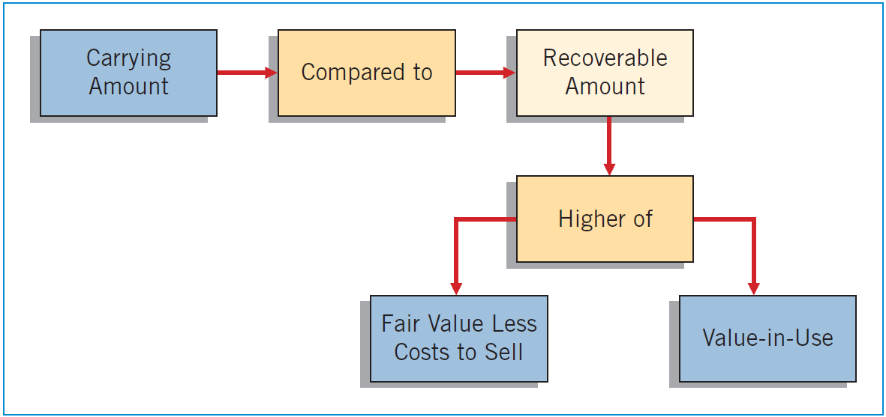
Recognizing Impairments
If impairment indicators are present, then an impairment test must be conducted.
可收回金额
ILLUSTRATION 11.15
Impairment Test
LO 3
Notes:
Recoverable amount is defined as the higher of fair value less costs to sell or value-in-use.
Fair value less costs to sell means what the asset could be sold for after deducting costs of disposal.
Value-in-use is the present value of net cash flows expected from the future use and eventual sale of the asset at the end of its useful life.

Slide 41
Recognizing Impairments
Example: Assume that Cruz SA performs an impairment test for its equipment. The carrying amount of Cruz’s equipment is €200,000, its fair value less costs to sell is €180,000, and its value-in-use is €205,000.
ILLUSTRATION 11.15
€200,000
€205,000
No Impairment
€180,000
€205,000
LO 3

Slide 42
Recognizing Impairments
Example: Assume the same information for Cruz Company except that the value-in-use of Cruz’s equipment is €175,000 rather than €205,000.
€20,000 Impairment Loss
ILLUSTRATION 11.15
€200,000
€180,000
€180,000
€175,000
LO 3

Slide 43
Recognizing Impairments
Example: Assume the same information for Cruz Company except that the value-in-use of Cruz’s equipment is €175,000 rather than €205,000.
€20,000 Impairment Loss
ILLUSTRATION 11.15
€200,000
€180,000
Cruz makes the following entry to record the impairment loss.
Loss on Impairment 20,000
资产减值损失——固定资产减值损失
Accumulated Depreciation—Equipment 20,000
固定资产减值准备
Account | Debit € | Credit €
LO 3
Notes:
The Loss on Impairment is reported in the income statement in the “Other income and expense” section.
The company then either credits Equipment or Accumulated Depreciation—Equipment to reduce the carrying amount of the equipment for the impairment.
资产减值损失-固定资产减值损失
固定资产减值准备

Slide 44
Impairment Illustrations
Case 1
At December 31, 2020, Hanoi Ltd. has equipment with a cost of VND26,000,000, and accumulated depreciation of VND12,000,000. The equipment has a total useful life of four years with a residual value of VND2,000,000. The following information relates to this equipment.
The equipment’s carrying amount at December 31, 2020, is VND14,000,000 (VND26,000,000 - VND12,000,000).
Hanoi uses straight-line depreciation. Hanoi’s depreciation was VND6,000,000 [(VND26,000,000 - VND2,000,000) ÷ 4] for 2020 and is recorded.
Hanoi has determined that the recoverable amount for this asset at December 31, 2020, is VND11,000,000.
The remaining useful life of the equipment after December 31, 2020, is two years.
LO 3

Slide 45
Impairment Illustrations
Case 1: Hanoi records the impairment on its equipment at December 31, 2020, as follows.
VND3,000,000 Impairment Loss
ILLUSTRATION 11.15
VND14,000,000
VND11,000,000
Account | Debit € | Credit €
Dec 31, 2020
Loss on Impairment 3,000,000
资产减值损失——固定资产减值损失
Accumulated Depreciation—Equipment 3,000,000
固定资产减值准备
LO 3

Slide 46
Impairment Illustrations
Equipment VND 26,000,000
Less: Accumulated Depreciation-Equipment 15,000,000
Carrying value (Dec. 31, 2020) VND 11,000,000
Hanoi Ltd. determines that the equipment’s total useful life has not changed (remaining useful life is still two years). However, the estimated residual value of the equipment is now zero. Hanoi continues to use straight-line depreciation and makes the following journal entry to record depreciation for 2021.
Account | Debit € | Credit €
Dec 31, 2021
Depreciation Expense 5,500,000
折旧费用
Accumulated Depreciation—Equipment 5,500,000
累计折旧——设备
LO 3
Notes:
Hanoi records depreciation in the periods following the impairment using the carrying amount of the asset adjusted for the impairment. Hanoi then evaluates whether the equipment was further impaired at the end of 2024. For example, the carrying amount of Hanoi’s equipment at December 31, 2024, is VND5,500,000 (VND26,000,000 − VND12,000,000 − VND3,000,000 − VND5,500,000). If Hanoi determines that the recoverable amount at December 31, 2024, is lower than VND5,500,000, then an additional impairment loss is recorded.

Slide 47
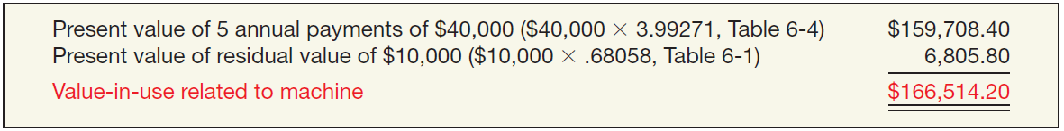
Impairment Illustrations
Case 2
At the end of 2019, Verma Company tests a machine for impairment. The machine has a carrying amount of $200,000. It has an estimated remaining useful life of five years. Because there is little market-related information on which to base a recoverable amount based on fair value, Verma determines the machine’s recoverable amount should be based on value-in-use. Verma uses a discount rate of 8 percent. Verma’s analysis indicates that its future cash flows will be $40,000 each year for five years, and it will receive a residual value of $10,000 at the end of the five years. It is assumed that all cash flows occur at the end of the year.
ILLUSTRATION 11.16
Value-in-Use Computation
LO 3

Slide 48
Impairment Illustrations
Case 2: Computation of the impairment loss on the machine at the end of 2019.
$33,486 Impairment Loss
ILLUSTRATION 11.15
$200,000
$166,514
Unknown
$166,514
LO 3

Slide 49
Impairment Illustrations
Case 2: Computation of the impairment loss on the machine at the end of 2019.
$33,486 Impairment Loss
$200,000
$166,514
Account | Debit € | Credit €
Loss on Impairment 33,486
资产减值损失——固定资产减值损失
Accumulated Depreciation—Machinery 33,486
固定资产减值准备
Dec 31, 2019
Unknown
$166,514
LO 3

Slide 50
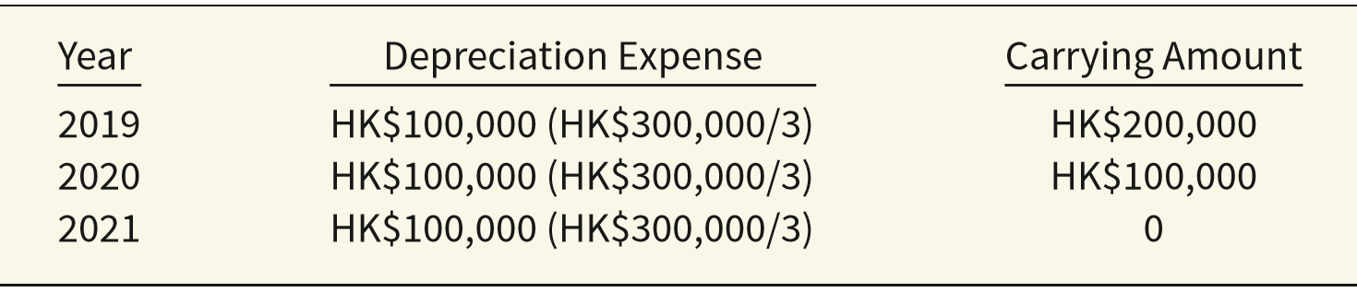
Reversal of Impairment Loss 减值损失转回
Illustration: Tan Group purchases equipment on January 1, 2019, for HK$300,000, useful life of three years, and no residual value.
At December 31, 2019, Tan records an impairment loss of HK$20,000.
Loss on Impairment 20,000
资产减值损失——固定资产减值损失
Accumulated Depreciation—Equipment 20,000
固定资产减值准备
LO 3
Notes:
After recording the impairment loss, the recoverable amount becomes the basis of the impaired asset. What happens if a review in a future year indicates that the asset is no longer impaired because the recoverable amount of the asset is higher than the carrying amount?

Slide 51
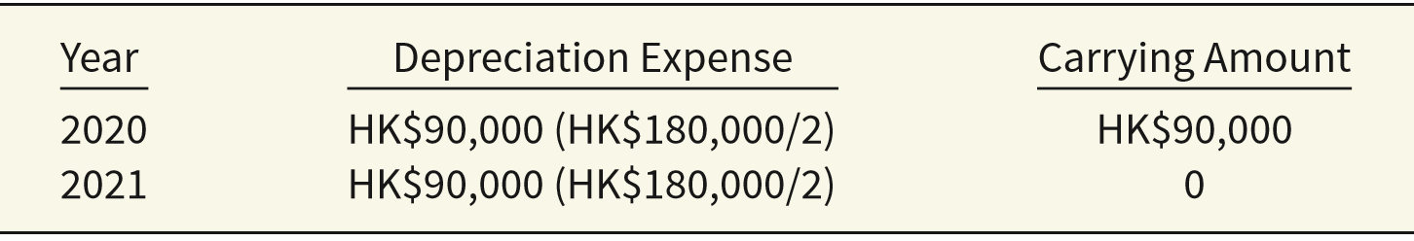
Reversal of Impairment Loss
Depreciation expense and related carrying amount after the impairment.
At the end of 2020, Tan determines that the recoverable amount of the equipment is HK$96,000. Tan reverses the impairment loss.
Account | Debit $ | Credit $
Accumulated Depreciation—Equipment 6,000
固定资产减值准备
Recovery of Impairment Loss 6,000
资产减值损失——固定资产减值损失
LO 3
Notes:
The amount of the recovery of the loss is limited to the carrying amount that would result if the impairment had not occurred.
The general rule related to reversals of impairments is as follows. The amount of the recovery of the loss is limited to the carrying amount that would result if the impairment had not occurred. For example, the carrying amount of Tan’s equipment at the end of 2023 would be HK$100,000, assuming no impairment. The HK$6,000 recovery is therefore permitted because Tan’s carrying amount on the equipment is now only HK$96,000. However, any recovery above HK$10,000 is not permitted. The reason is that any recovery above HK$10,000 results in Tan carrying the asset at a value above its historical cost.
我国会计准则不允许长期资产减值转回！！！

Slide 52
Reversal of Impairment Loss in
China GAAP！！！
考虑到固定资产、无形资产‘商誉等资产发生减值后，一方面价值回升的可能性较少，通常属于永久性减值；
另一方面，为了避免确认资产重估增值和操纵利润，资产减值损失一经确认，在以后会计期间不得转回。
以前期间计提资产减值准备，需要等到资产处置时才可转出。
LO 3
Notes:
The amount of the recovery of the loss is limited to the carrying amount that would result if the impairment had not occurred.
The general rule related to reversals of impairments is as follows. The amount of the recovery of the loss is limited to the carrying amount that would result if the impairment had not occurred. For example, the carrying amount of Tan’s equipment at the end of 2023 would be HK$100,000, assuming no impairment. The HK$6,000 recovery is therefore permitted because Tan’s carrying amount on the equipment is now only HK$96,000. However, any recovery above HK$10,000 is not permitted. The reason is that any recovery above HK$10,000 results in Tan carrying the asset at a value above its historical cost.
我国会计准则不允许长期资产减值转回！！！

Slide 53
Impairments
Cash-Generating Units
When it is not possible to assess a single asset for impairment because the single asset generates cash flows only in combination with other assets, companies identify the smallest group of assets that can be identified that generate cash flows independently of the cash flows from other assets.
LO 3

Slide 54
Impairments
Impairment of Assets to Be Disposed Of
持有待售资产减值
What happens if a company intends to dispose of the impaired asset, instead of holding it for use?
Report the impaired asset at the lower-of-cost-or-net realizable value (fair value less costs to sell).
No depreciation or amortization is taken on assets held for disposal during the period they are held.
Can write up or down an asset held for disposal in future periods, as long as the carrying amount after the write up never exceeds the carrying amount of the asset before the impairment.
LO 3
Notes:
What happens if a company intends to dispose of the impaired asset, instead of holding it for use?
assets held for disposal are like inventory; companies should report them at the lower-of-cost-or-net realizable value.
In other words, assets held for disposal are like inventory; companies should report them at the lower-of-cost-or-net realizable value.

Slide 55
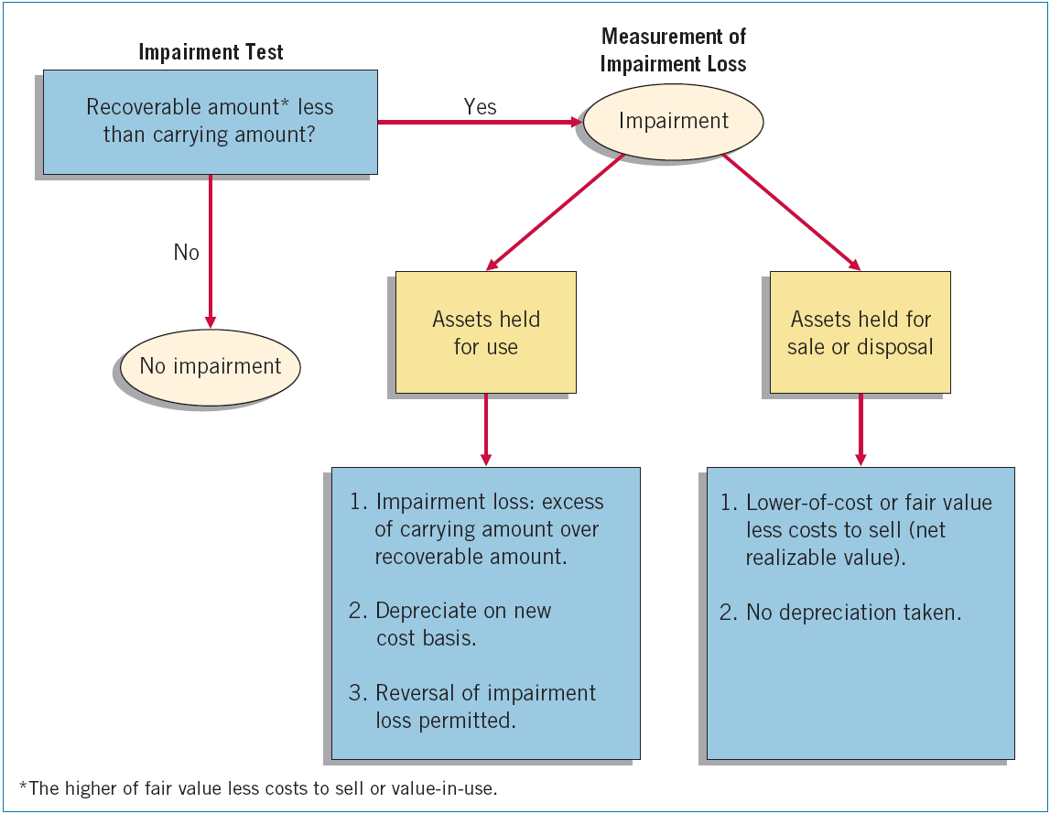
ILLUSTRATION 11.18
Graphic of Accounting for Impairments
LO 3

Slide 56
单选题
1分
Quick Check #4
All of the following are true with regard to impairment testing of long-lived assets except
此题未设置答案，请点击右侧设置按钮
A
if impairment indicators are present, the company must conduct an impairment test.
B
the impairment test compares the asset’s carrying value with the lower of its fair value less cost to sell and its value-in-use.
C
if the recoverable amount is lower than the carrying value, an impairment loss will be reported on the period’s income statement.
D
if either the fair value less cost to sell or the value-in-use is higher than the carrying amount, no impairment loss will be recorded.
Submit

Slide 57
单选题
Quick Check #5
Erie Corporation owns machinery with a book value of $2,200,000. It is estimated that the machinery will generate future cash flows of $1,995,000. The machinery has a fair value (recoverable amount) of $1,915,000. The journal entry to record the impairment loss will
1分
此题未设置答案，请点击右侧设置按钮
A
record a discontinued operations loss of $80,000.
B
increase the asset’s Accumulated Depreciation account by $285,000.
C
reduce income from continuing operations by $205,000.
D
include a $285,000 credit to the asset account.
Submit

Slide 58
LEARNING OBJECTIVE 4
Demonstrate how to report and analyze property, plant, equipment.

Slide 59
Presentation and Analysis
Presentation of Property,
Plant, Equipment
Depreciating assets, use Accumulated Depreciation.
Disclosures
Basis of valuation (usually cost)
Pledges, liens, and other commitments
LO 6

Slide 60

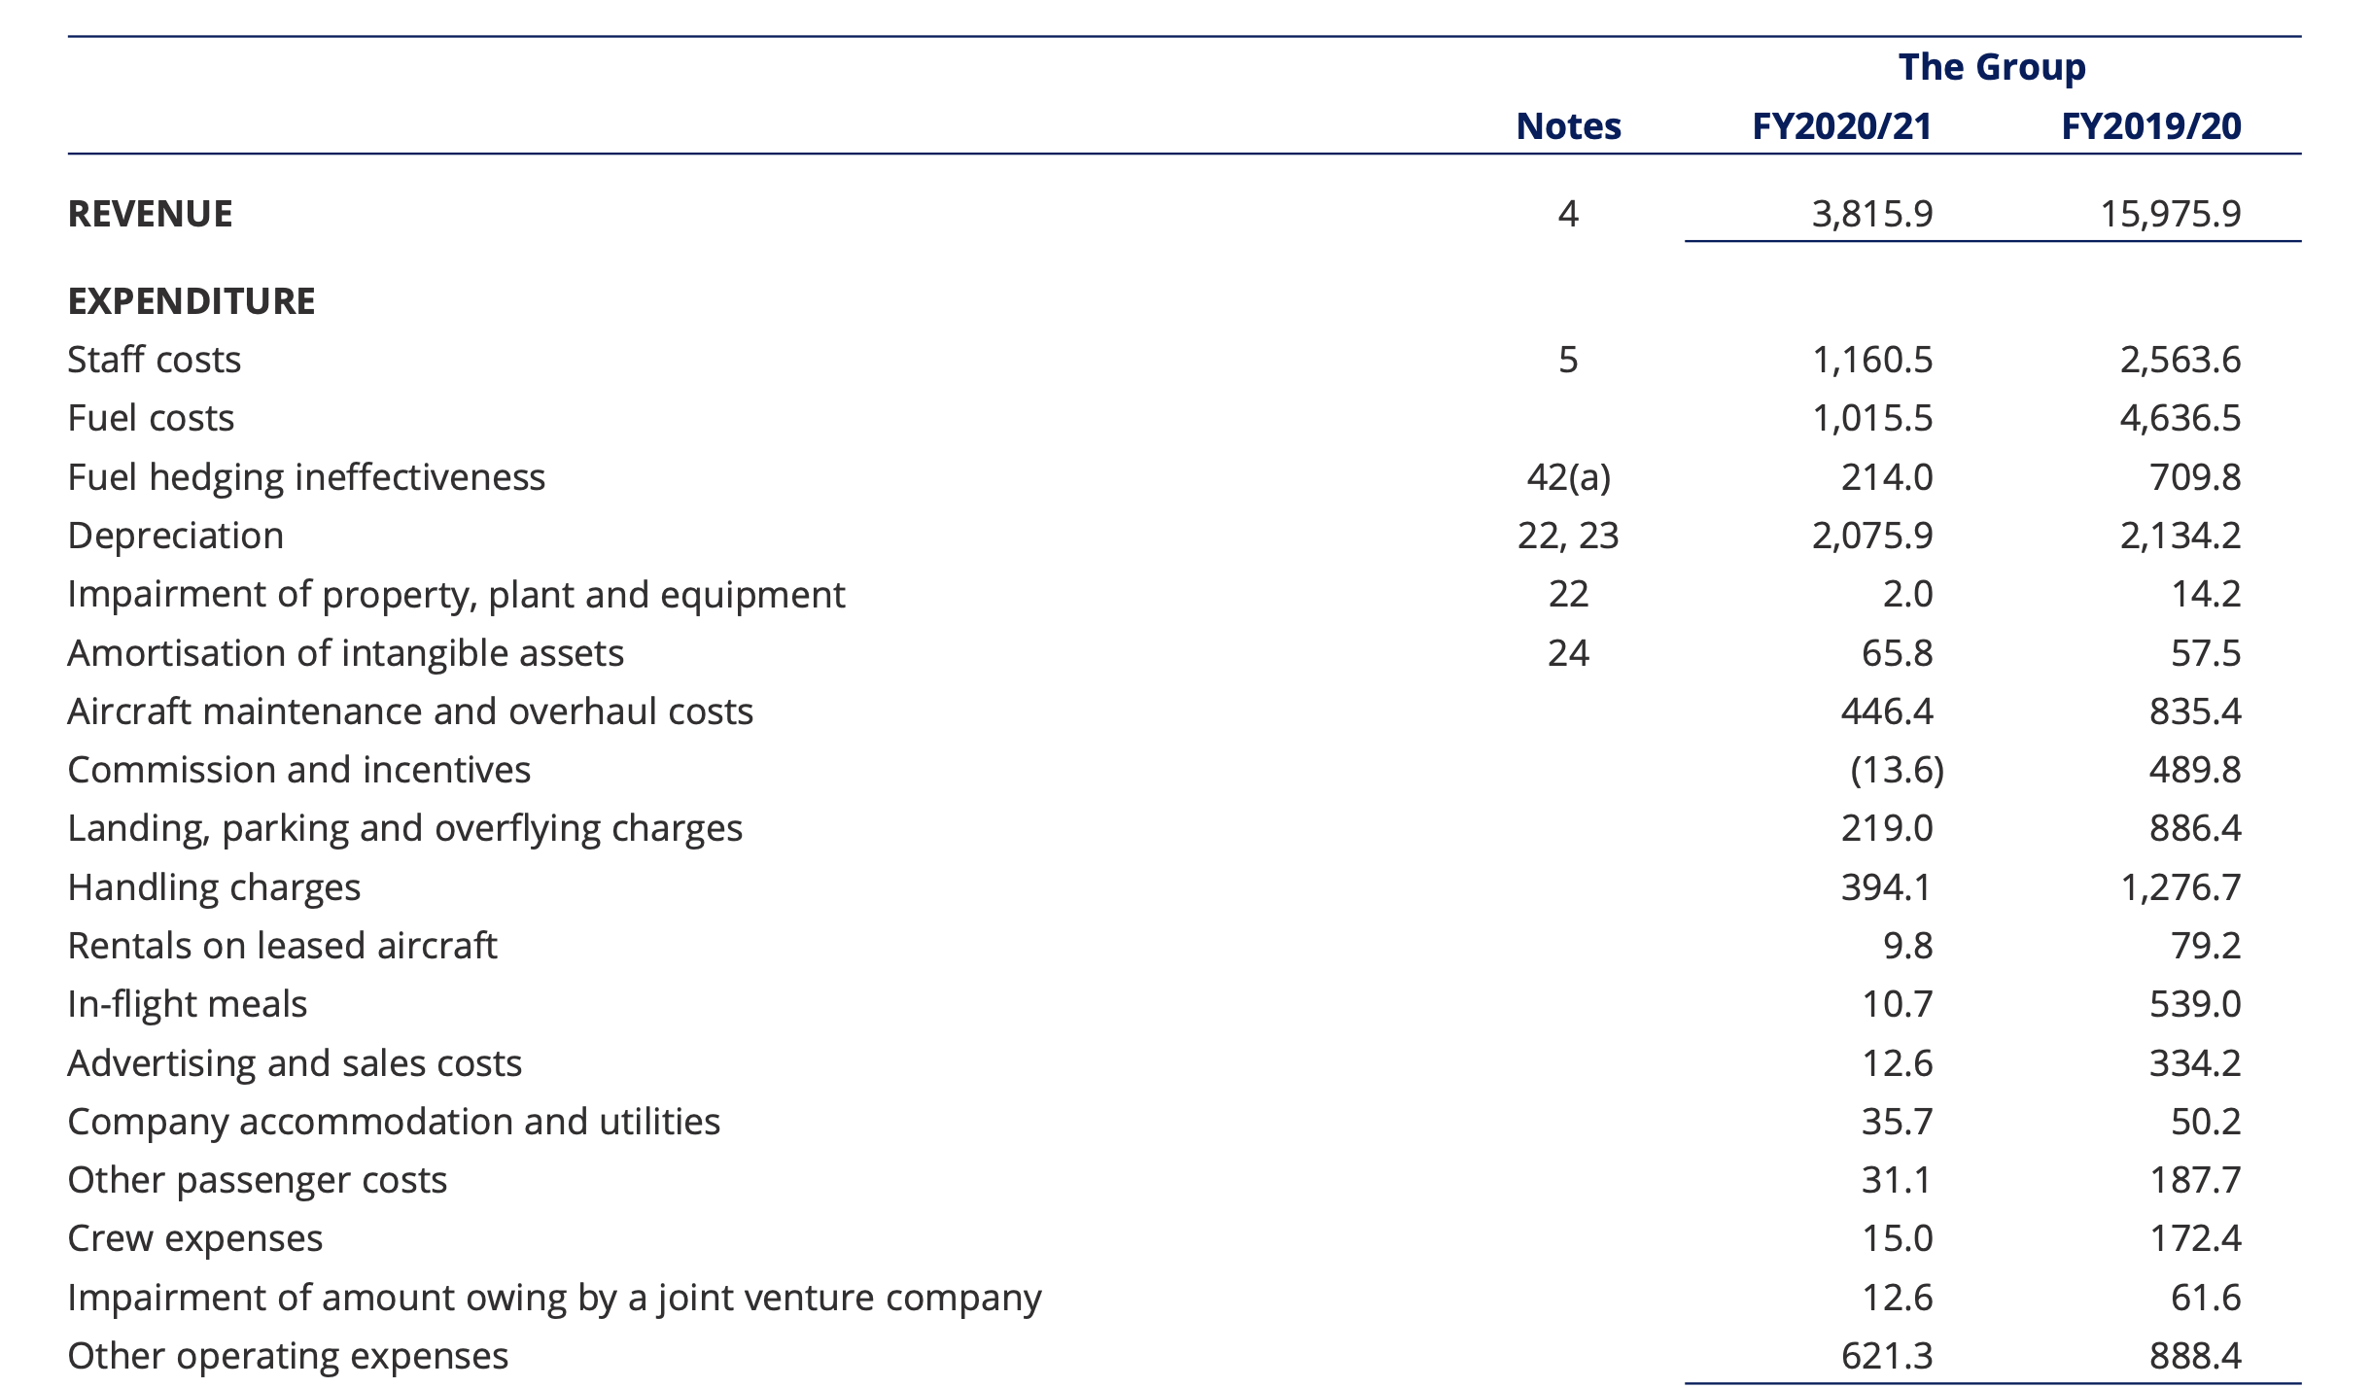

Slide 61
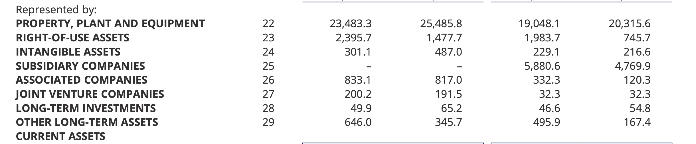
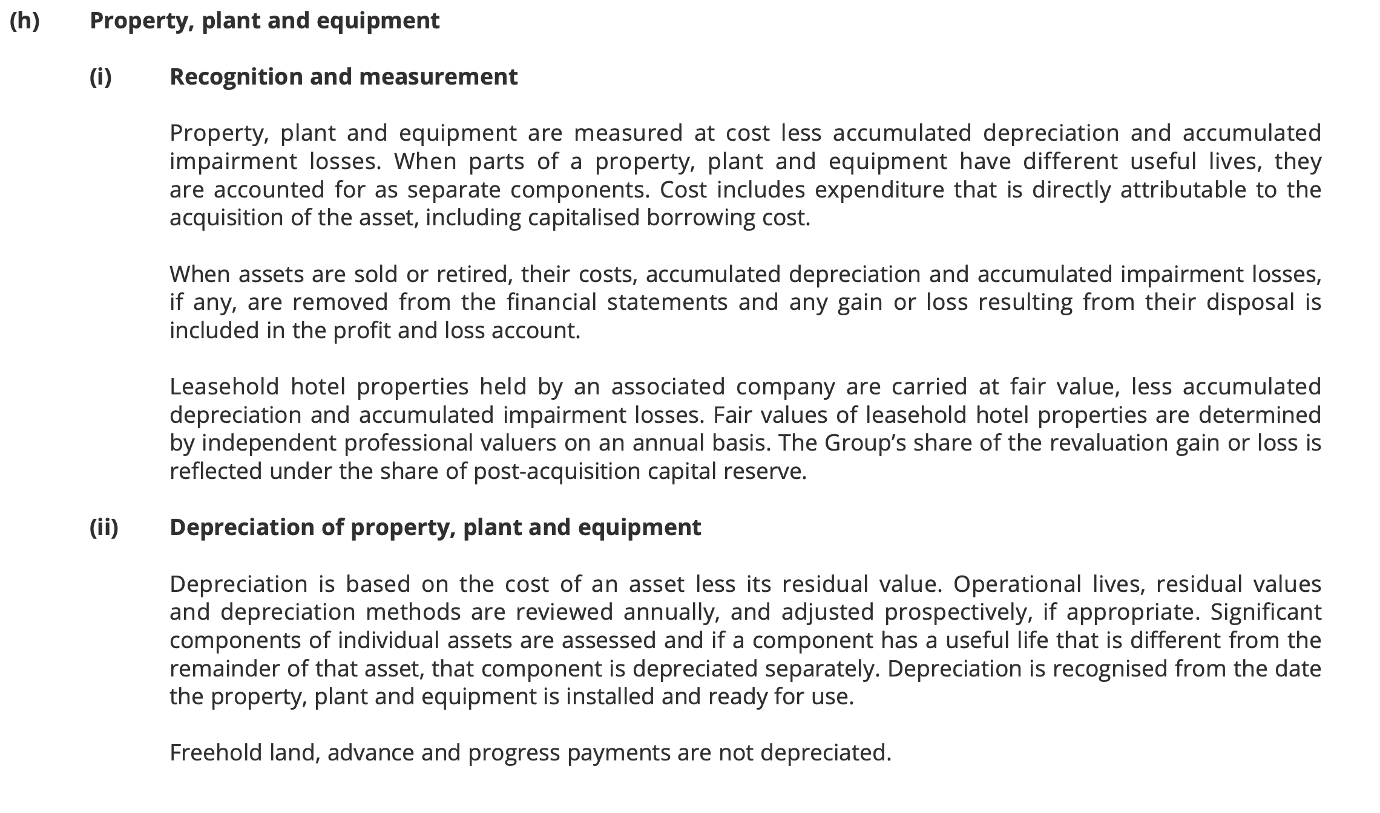

Slide 62
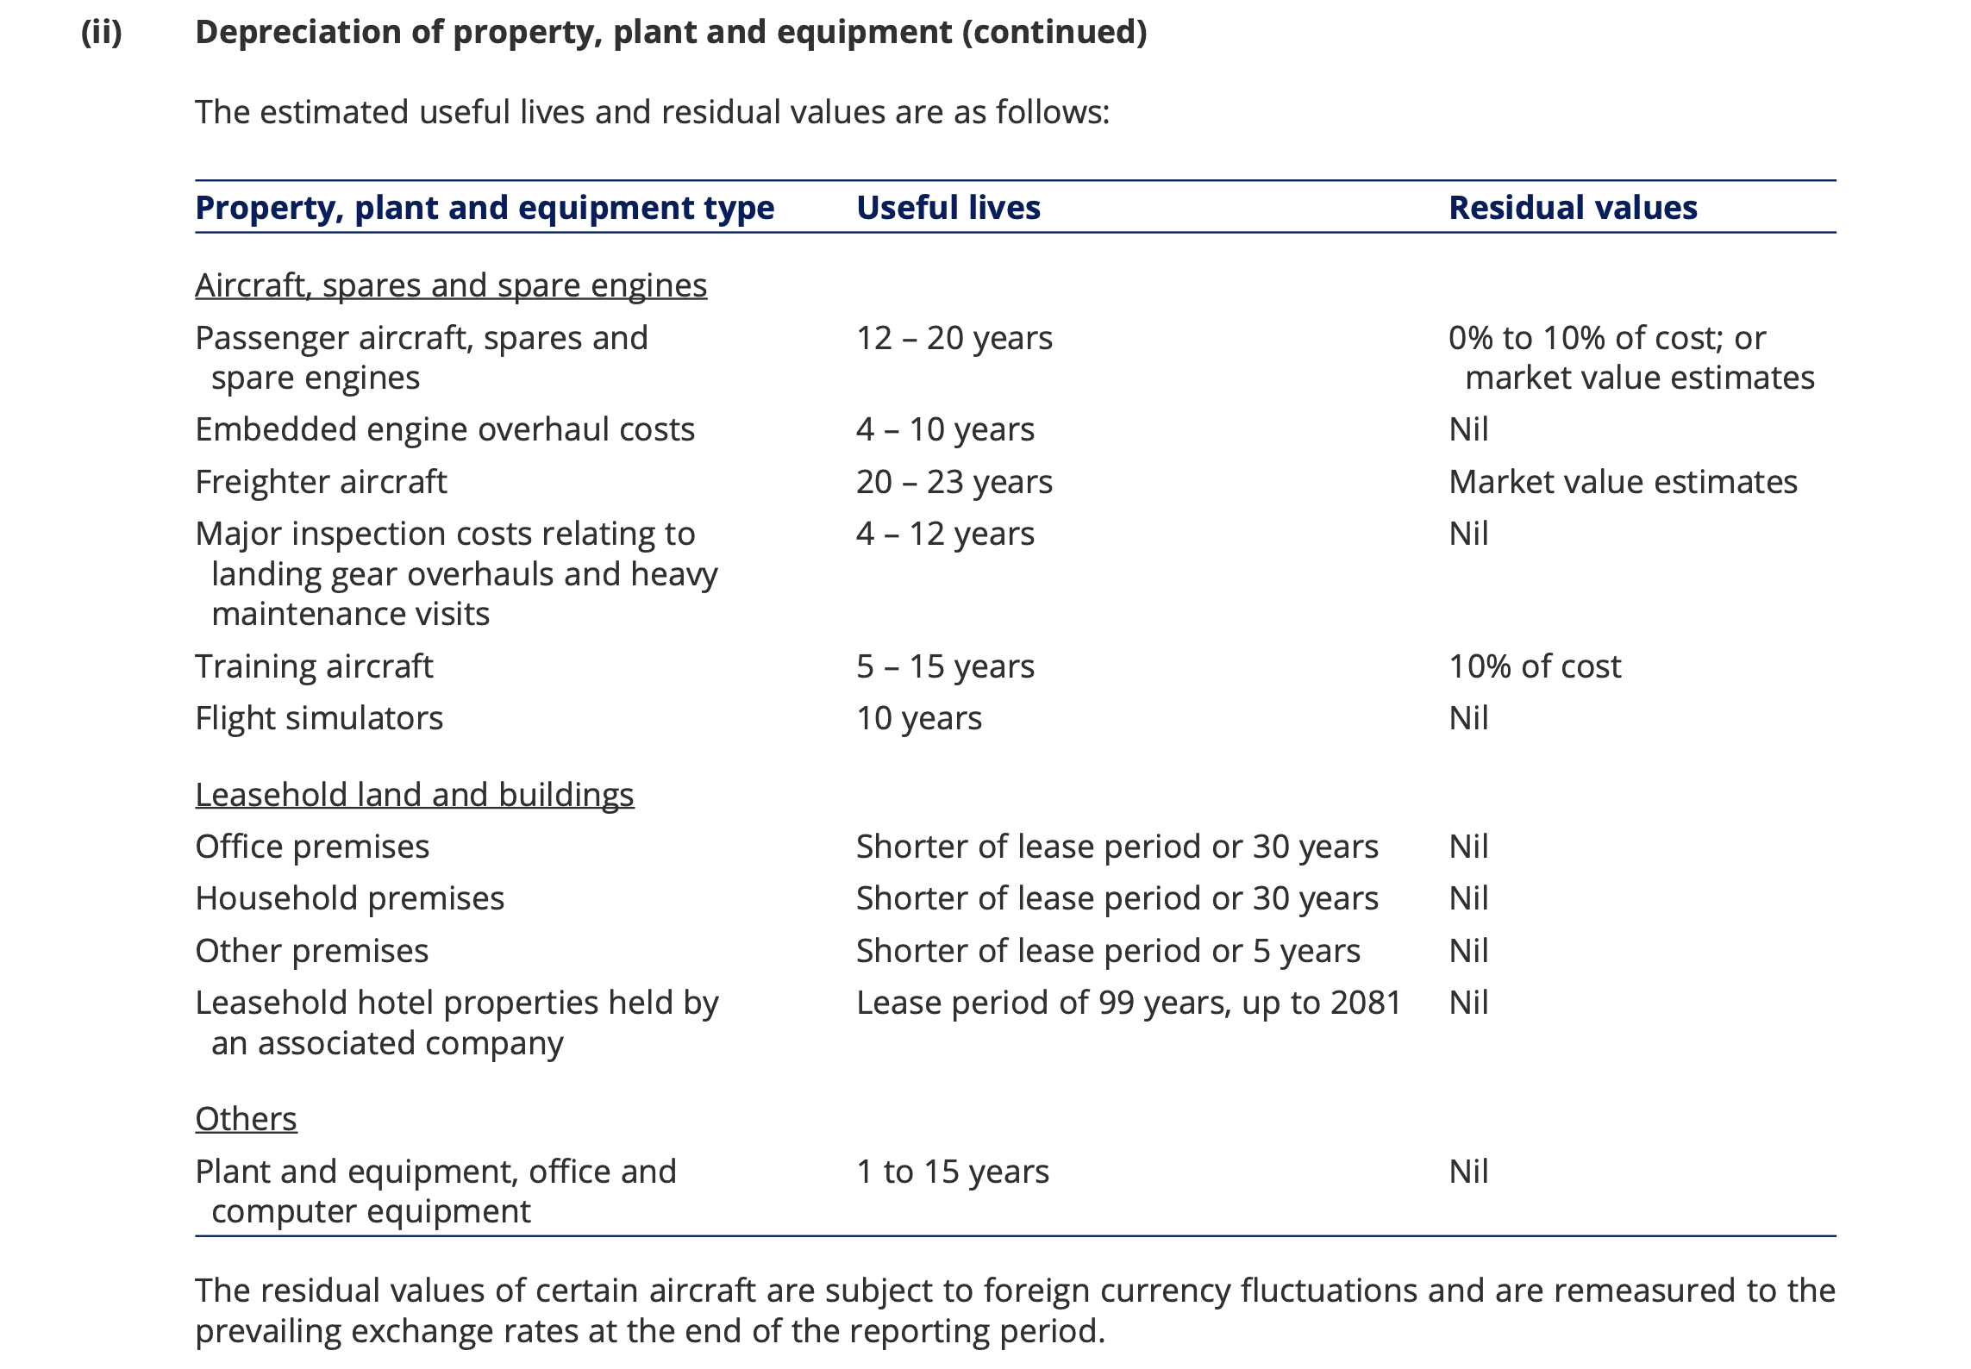

Slide 63
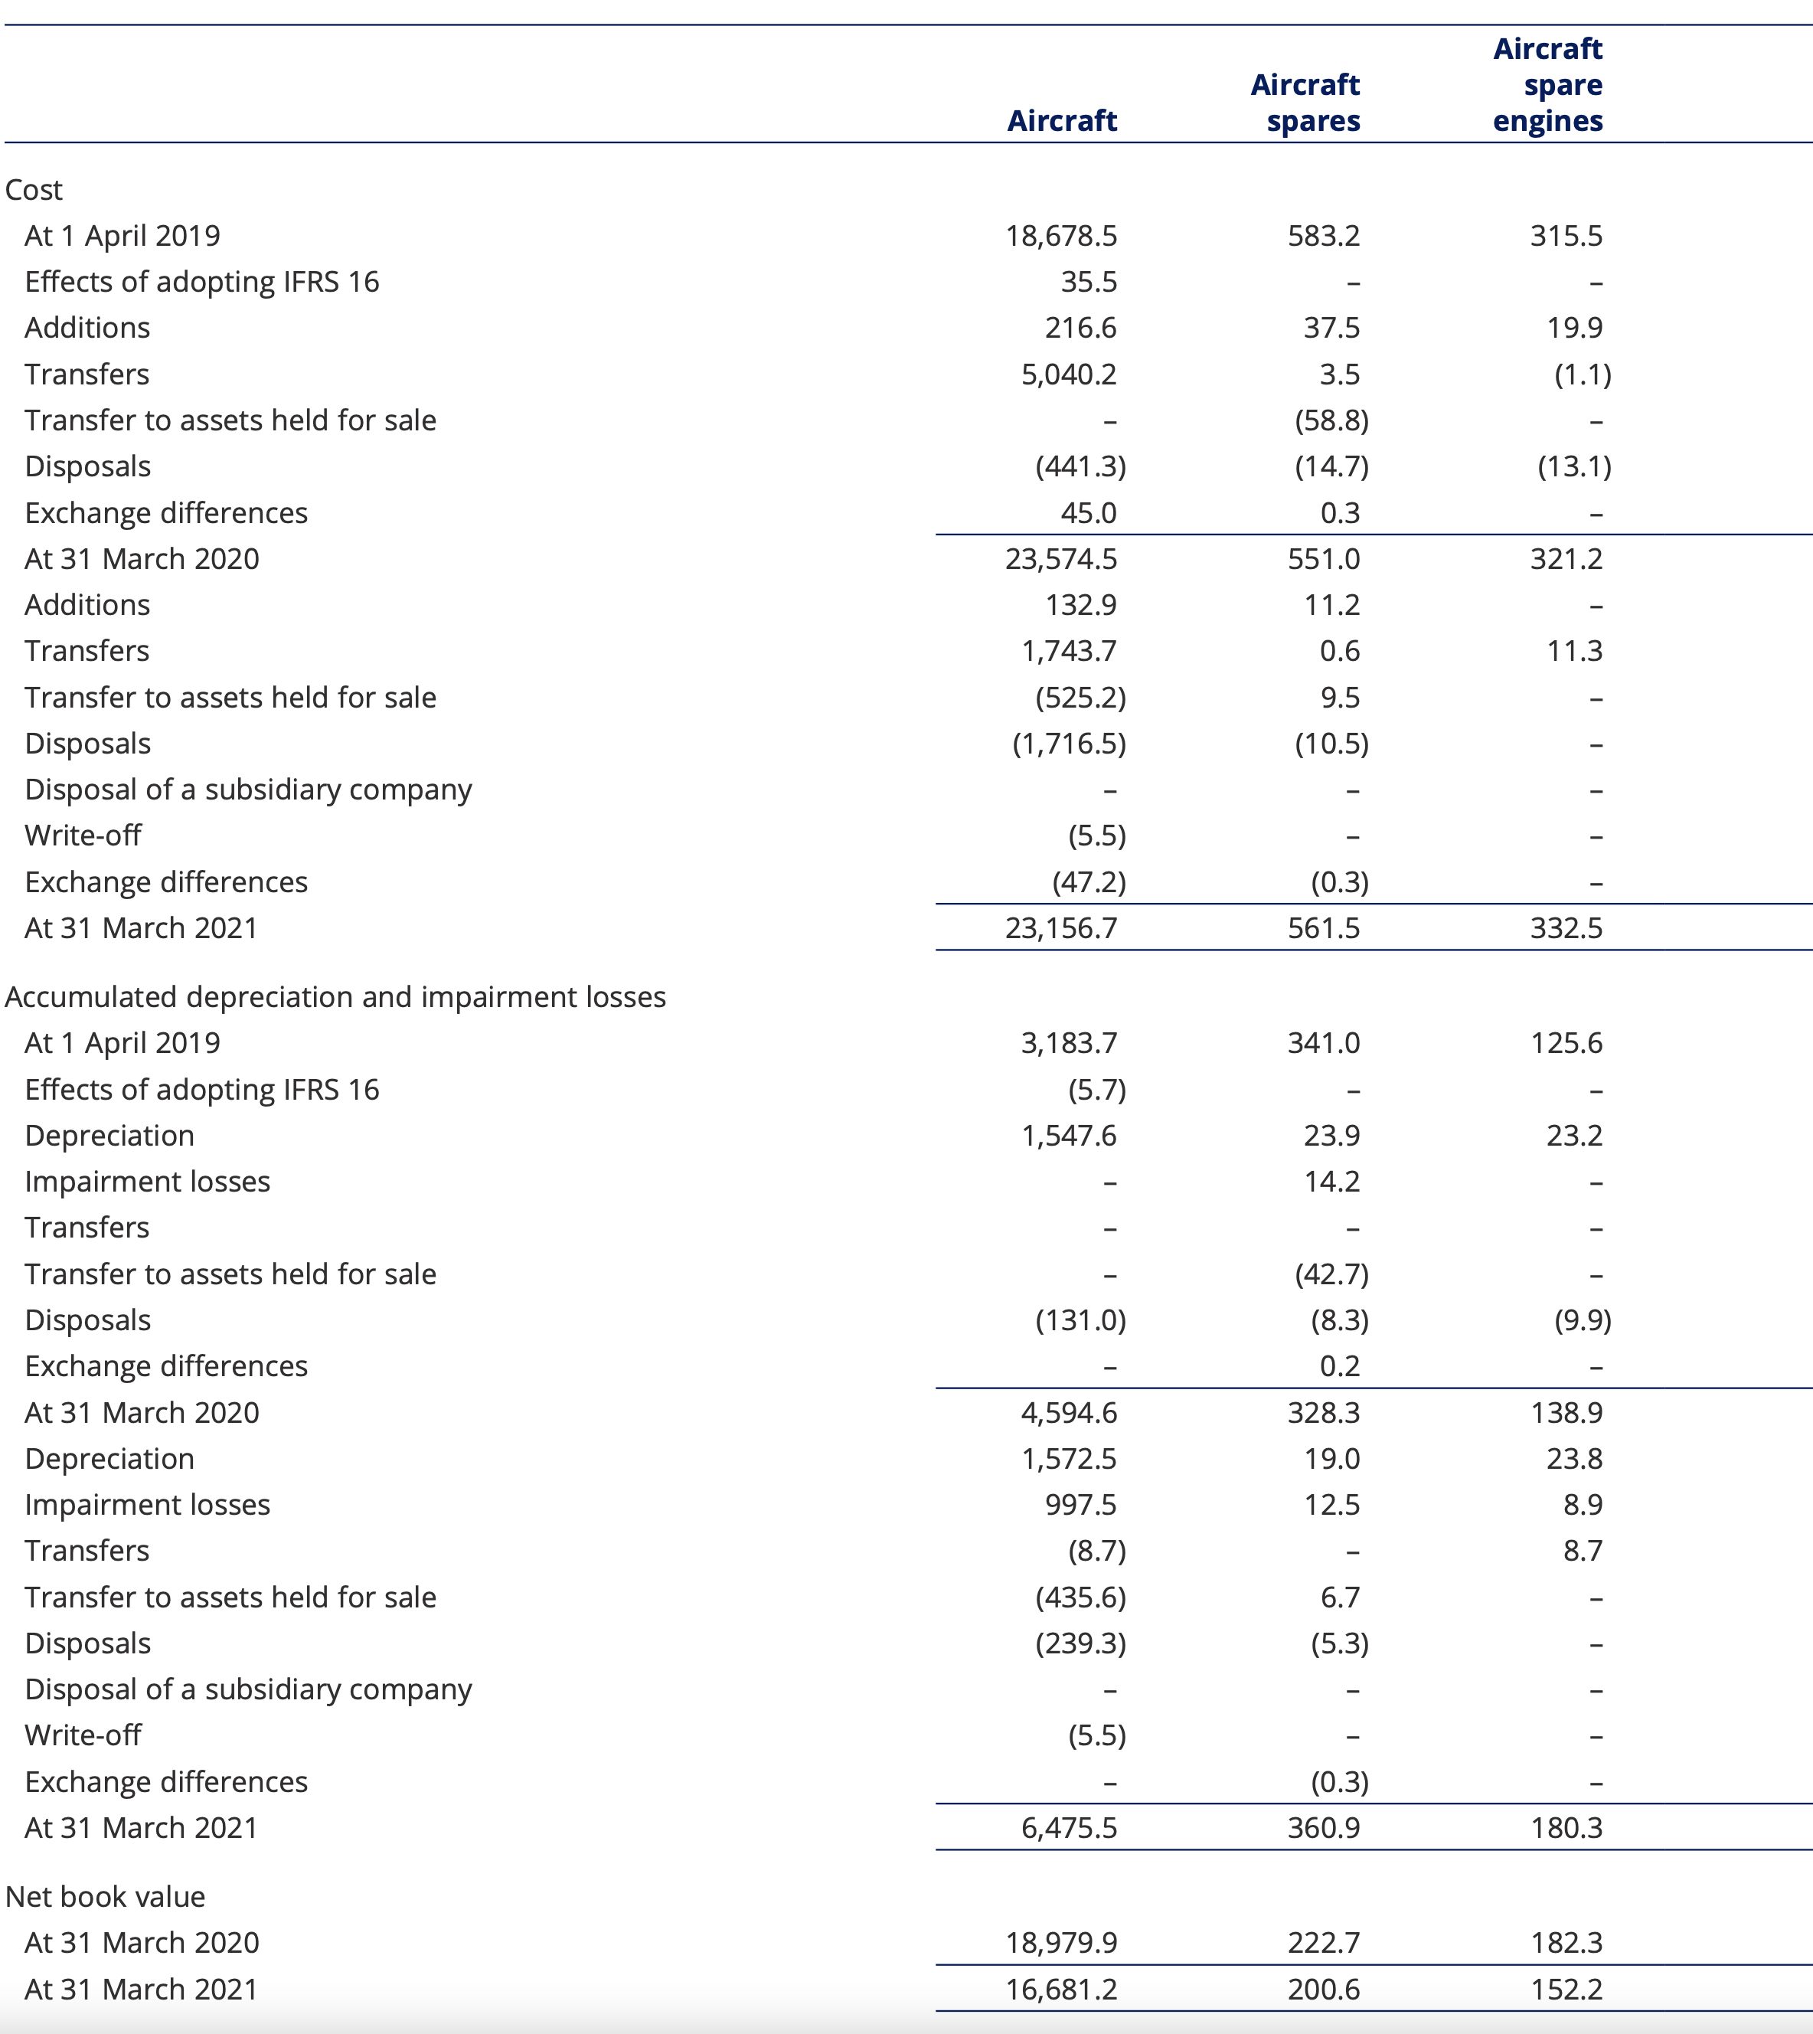

Slide 64
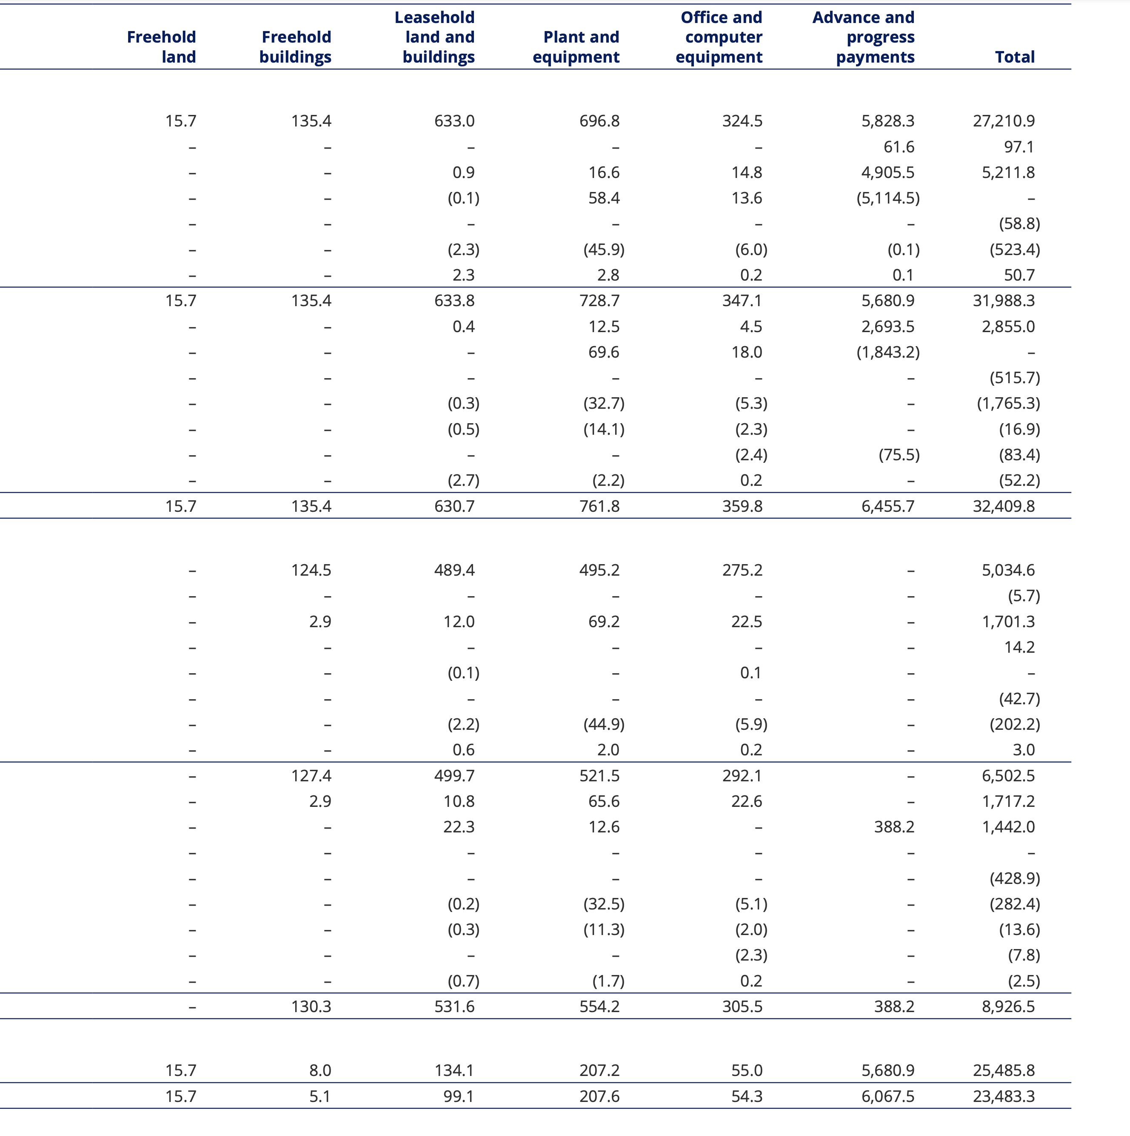

Slide 65
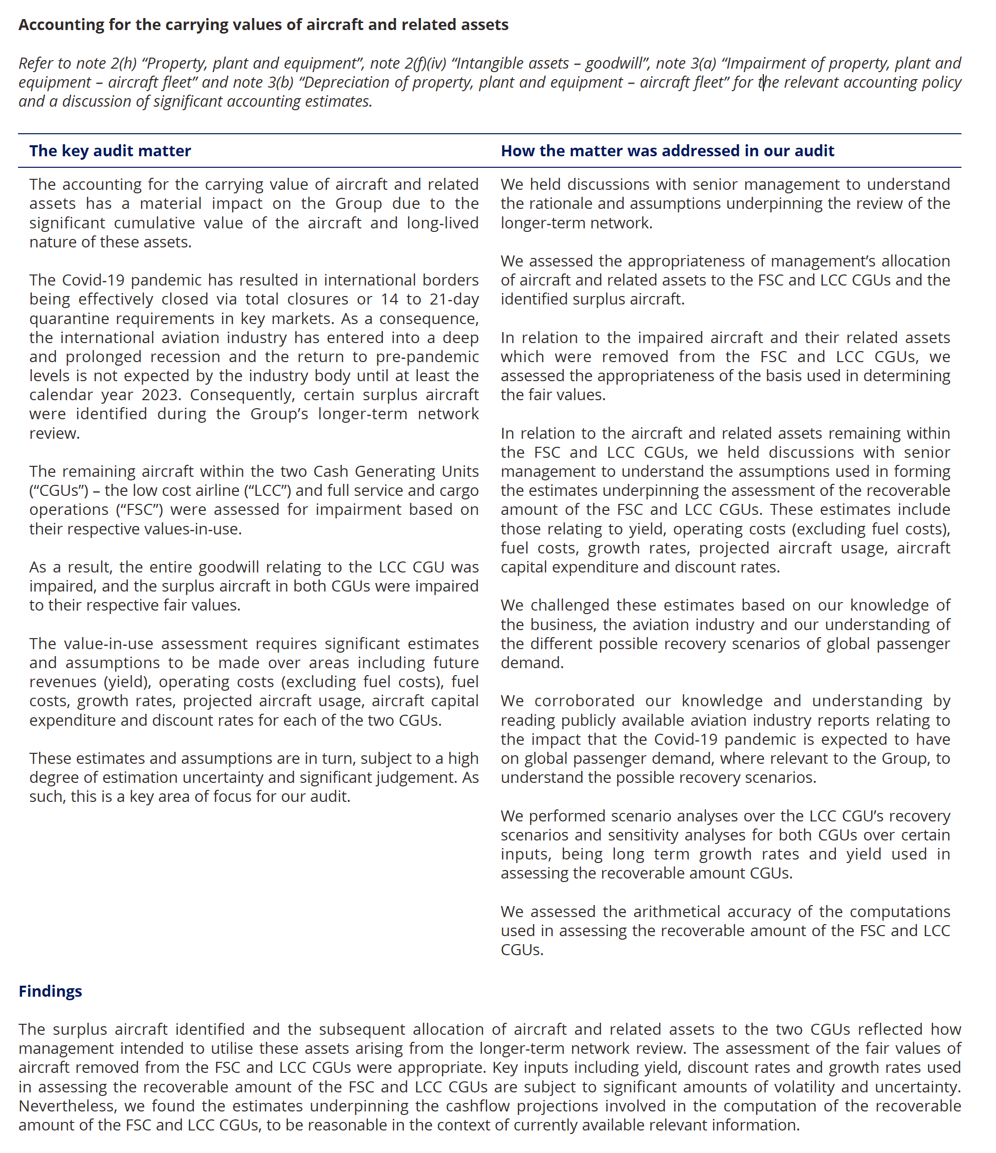

Slide 66


感谢您的参与！
THE HITSZ
SCHOOL OF ECONOMICS
AND MANAGEMENT

